Slide 1
Handle Imbalanced Data in Machine Learning
Achyuthuni Sri Harsha

Slide 2

Roadmap
What is Imbalanced Data
Handling Imbalanced Data
SMOTE

Slide 3

What is Imbalanced Data
One of the most common problems when working with classification tasks is imbalanced data where one class is dominating over the other.
For example, in the Credit Card fraud detection task, there will be very few fraud transactions (positive class) when compared with non-fraud transactions (negative class).
Sometimes, it is even possible that 99.99% of transactions will be non-fraud and only 0.01% of transactions will be fraud transactions

Slide 4
Why should you worry about Imbalanced Data?
Consider the same example of credit card fraud transaction detection where fraud and non-fraud transactions are in the ratio of 99% and 1% respectively.
This is a highly imbalanced dataset. If you were to train the model on this dataset, you will get accuracy as high as 99% because the classifier will pick up the patterns in the popular classes and predict almost everything as non-fraud transactions.
As a result, the model will fail to generalize on the new data. This is also the reason why accuracy is not a good evaluation metric when dealing with imbalanced data.

Slide 5
Handling Imbalanced Data
Get More Data
Change Evaluation Metric
Change the Algorithms
Resampling Techniques
Generate Synthetic Samples

Slide 6
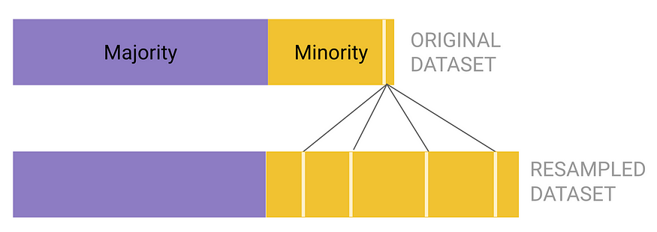
Strategy 1. Random Oversampling
It helps to increase the number of minority class examples in the dataset.
One of the main advantages of oversampling is no information is lost from both the majority and minority classes during the process.
It is prone to overfitting.
It is recommended when the dataset is not too large

Slide 7
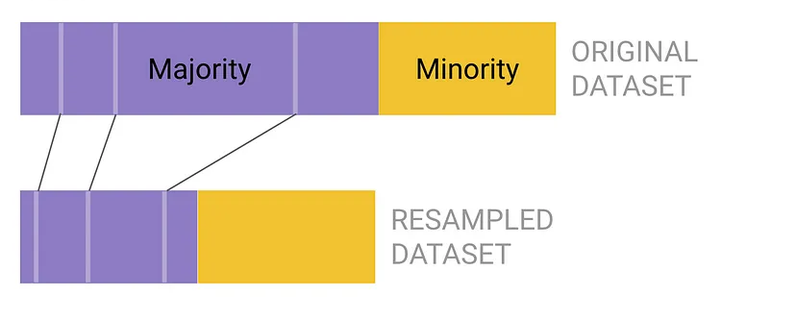
Strategy 2. Random Undersampling
Conversely, random undersampling removes existing samples from the majority class.
Each data point in the majority class has an equal chance of being removed.
Undersampling also leads to underfitting and poor generalization of the test set.

Slide 8
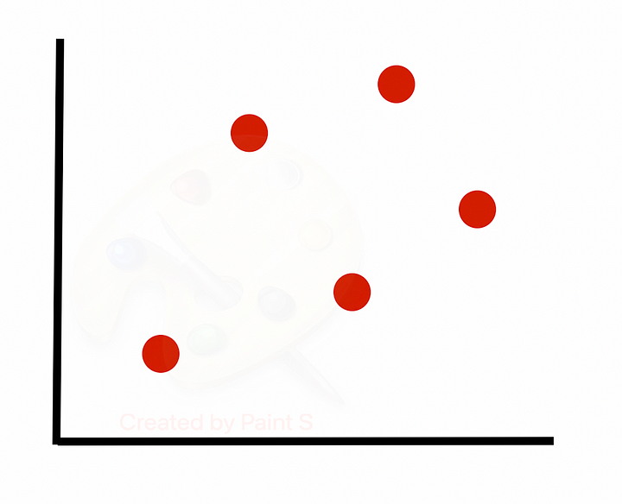
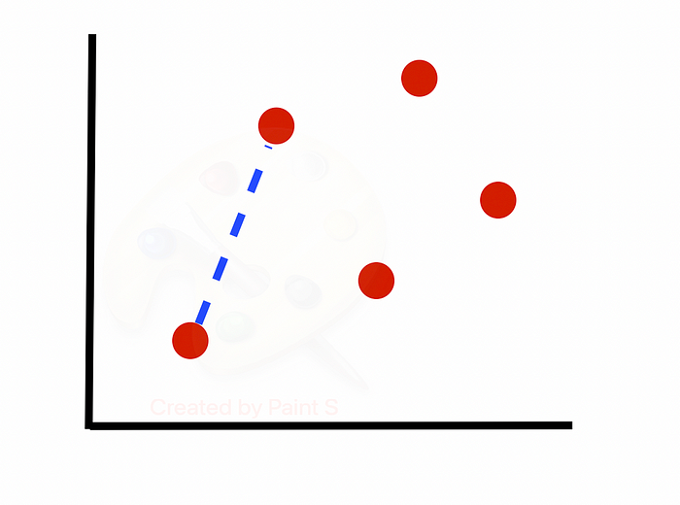
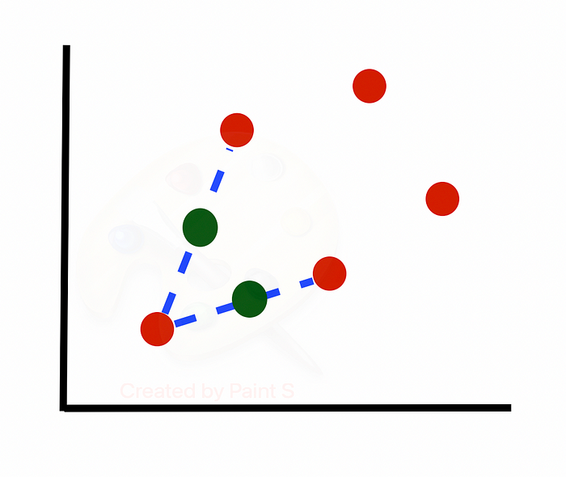
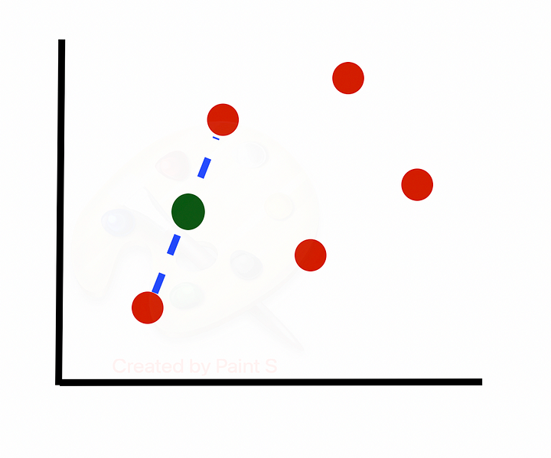
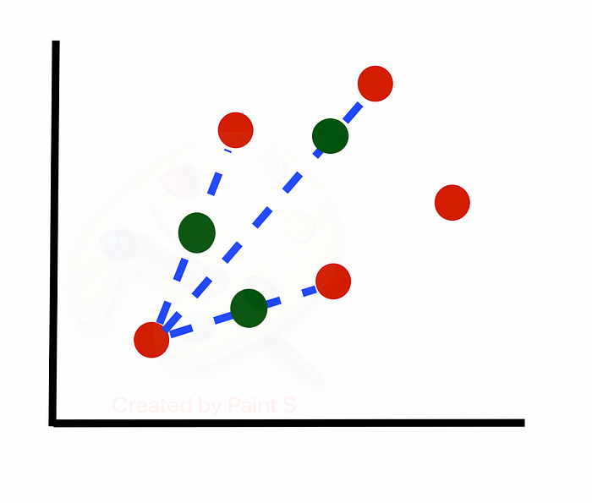
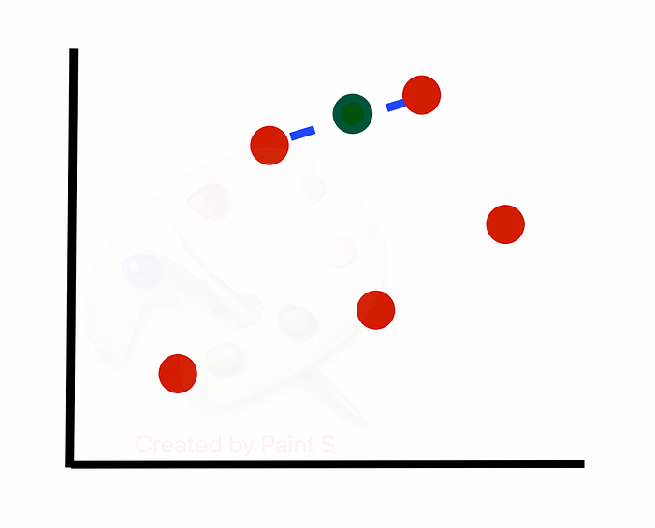
Oversampling with SMOTE
Synthetic Minority Over-sampling Technique
SMOTE is an oversampling method that creates synthetic samples from the minority class.
It works by selecting minority observations that are similar to each other and drawing a line between the examples in order to create new synthetic samples

Slide 9
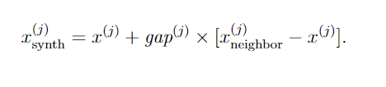
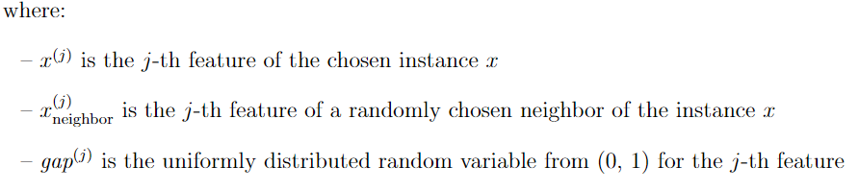
Oversampling with SMOTE
Take difference between a sample and its nearest neighbour
Multiply the difference by a random number between 0 and 1
Add this difference to the sample to generate a new synthetic example in feature space
Continue on with next nearest neighbour up to user-defined number

Slide 10

Under-Sampling: Tomek Links
Tomek links are pairs of very close instances but of opposite classes.
Removing the instances of the majority class of each pair increases the space between the two classes, facilitating the classification process

Slide 11
References
https://medium.com/@corymaklin/synthetic-minority-over-sampling-technique-smote-7d419696b88c
https://medium.com/analytics-vidhya/machine-learning-how-to-handle-class-imbalance-920e48c3e970
https://medium.com/analytics-vidhya/machine-learning-how-to-handle-class-imbalance-920e48c3e970
https://analyticsindiamag.com/correcting-class-imbalanced-data-for-binary-classification-problems-demonstrations-using-animated-videos/

Slide 12
Thanks

